Slide 1

SESSION 5 — Loops (for, while, do-while)
Shubham Rawat

Slide 2

Session Objective
By the end of this session, students will:
Understand looping constructs in Java
Execute repetitive tasks using loops
Differentiate for, while, and do-while loops
Use break and continue statements
Create nested loop programs

Slide 3

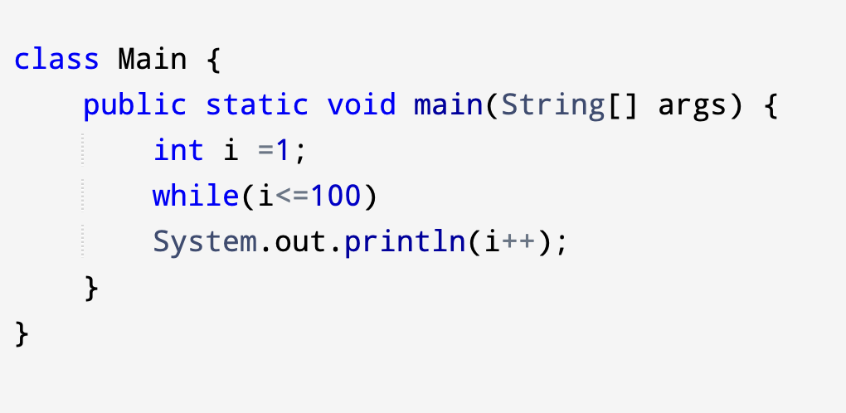
What is a Loop?
A loop repeats a block of code multiple times
Used when tasks must execute repeatedly
Reduces code duplication
Controlled using conditions
Real-life example:
Printing numbers 1–100
Generating tables
Pattern printing

Slide 4

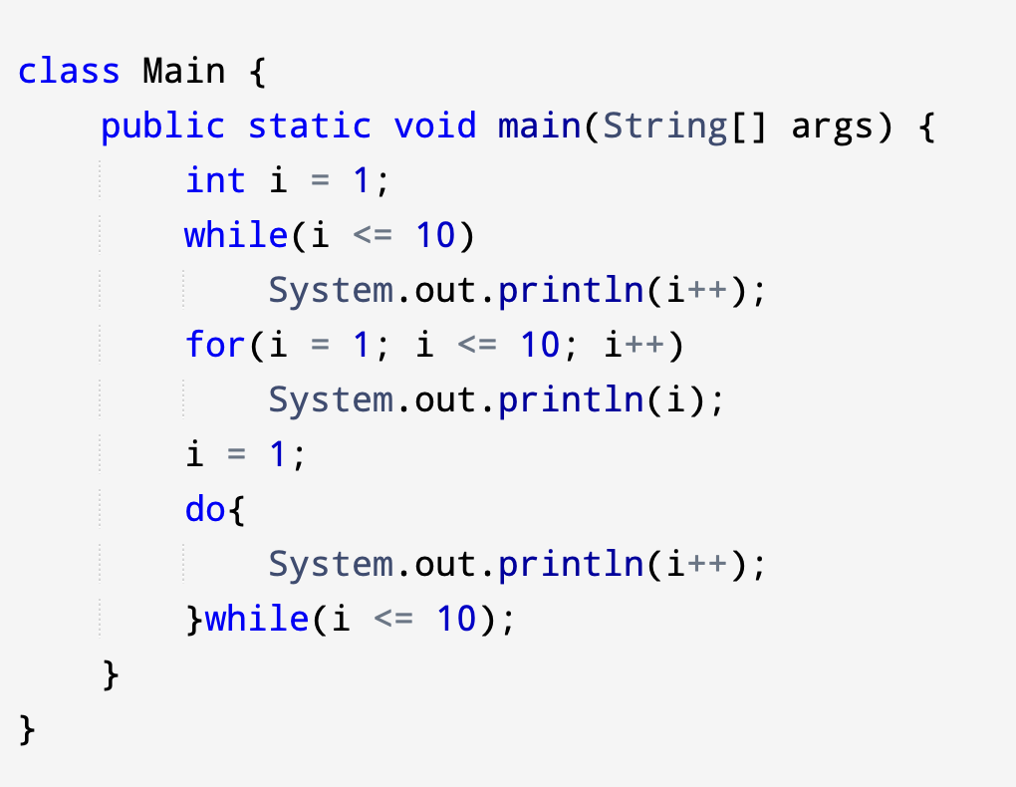
Types of Loops in Java
Java provides three loops:
for loop
while loop
do-while loop
Each loop is used depending on the situation.

Slide 5
for Loop
Used when number of iterations is known.
Syntax:
for(initialization; condition; update) {
// code
}
for(int i = 1; i <= 10; i++) {
System.out.println(i);
}
Execution Flow:
Initialization runs once
Condition checked
Code executes
Update happens

Slide 6

When to Use for Loop
When to Use for Loop
Best used when:
Iterations are fixed
Counting required
Arrays or tables
Examples:
Multiplication tables
Counting numbers

Slide 7

while Loop
Used when number of iterations is unknown.
Syntax:
while(condition) {
// code
}
Example:
int i = 1;
while(i <= 5) {
System.out.println(i);
i++;
}
Best used for:
User input validation
Menu programs
Unknown repetitions
Example:
Keep asking password until correct.

Slide 8

DO-WHILE LOOP
int i = 1;
do {
System.out.println(i);
i++;
} while(i <= 5);
Condition checked after execution.
Executes at least once.
Syntax:
do {
// code
} while(condition);

Slide 9

Loop Comparison
Loop | Condition Check | Runs Minimum
for | Before | 0 times
while | Before | 0 times
do-while | After | 1 time

Slide 10

break Statement
continue Statement
Immediately exits loop
Example:
for(int i=1;i<=10;i++){
if(i==5)
break;
System.out.println(i);
}
Output stops at 4.
Skips current iteration
Example:
for(int i=1;i<=5;i++){
if(i==3)
continue;
System.out.println(i);
}
Output skips 3.

Slide 11
Infinite Loop
Nested Loops
Loop that never stops.
Example:
while(true){
System.out.println("Running...");
}
Cause:
Condition never becomes false.
Loop inside another loop.
Example:
for(int i=1;i<=3;i++){
for(int j=1;j<=3;j++){
System.out.print("* ");
}
System.out.println();
}
Cause:
Condition never becomes false.

